Slide 1

HBS HIGHLIGHTER
Department of Computer Science and Applications
Panjab University, Chandigarh
Submitted By
Vishal
Roll No. 38
Pupin No: 17815002166
MCA VI Sem Morning
Submitted To
Mr. Mohinder Singh Negi

Slide 2

Company Information
Hashedin By Deloitte
HashedIn by Deloitte is one of India's leading technology firms that is specialized in offering software modernization and product innovation solutions.
Stipend Paid
Stipend Paid by the company : 21200
Working Hours in the company
5 days a week
8 hours a day

Slide 3
Journey So Far.
Hashedin University : HU is a 2 month intense bootcamp training program for newly recruited engineers to transform them into industry-ready leaders. Started from Feb 1 2021 to Apr-5.
Technician Courses learnt during HU
HTML, CSS, Git
Typescript
React
Java Spring Boot
Python Django
Project Assigned after going through five tracks listed above.
Mutual Fund Portfolio Analyzer
HBS Highlighter

Slide 4
Timelines
Work Done | Time
HU Training | Feb 1st - Mar-12
Mutual Fund PortFolio Analyzer | Mar15-Apr-5
HBS Highlighter | Apr-12 - May24

Slide 5
About HBS Highlighter
HBS Highlighter is a SaaS based application. This app is useful for students, scholars.It helps them to highlight any text content from any website and can save them. Later they can visit highlighter’s website to see their highlights and can manage them.
It is a chrome extension which would be available in chrome-web store. Users can download the chrome extension and enable it to use its features.
Anybody who is mainly searching on many online websites and creating some
kind of database ( like writing the content manually on papers) or want to save
something for later reference.
Product that offers features that match the functionality of existing products while enhancing user experience with additional features such as reminder service.

Slide 6
Usefulness of the Project
Can save content from any website with minimal effort.
Can categorize or organize content using tags for easy filtration and searching.
Easily find saved contents using tag filtration and searching through keywords.
Do not have to waste time for searching lost contents.
Add context information easily.
A single place to store all your contents.

Slide 7
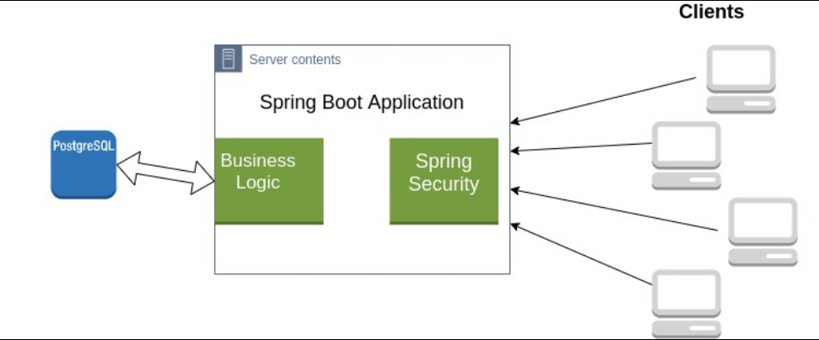
Architectural Design

Slide 8
Technical Stack
Database
Postgres
Backend
Business Logic
Business is written in spring boot and exposed to Front-end via APIs. Some APIs as follows.
Save a highlighted content.
Delete a highlighted content.
Search highlight.
Get all tags.
Login
Registration
etc.
Spring Security
All APIs except Login and Registration are protected via Spring Security.
Front-end
React Web Application
Chrome extension

Slide 9
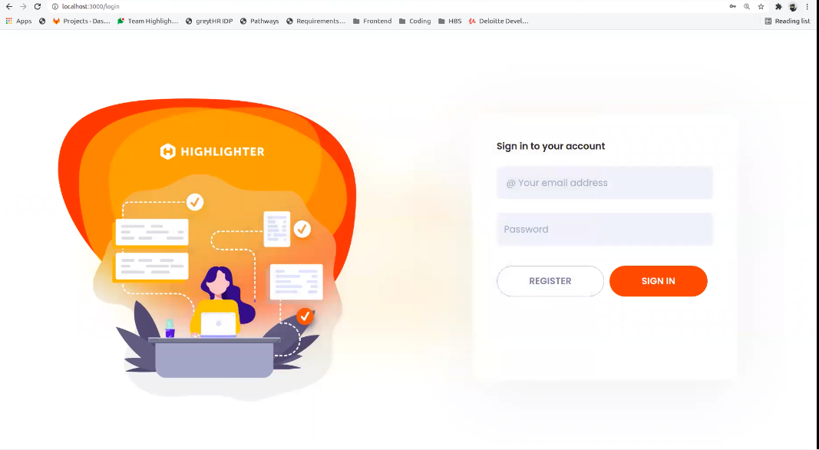

Slide 10
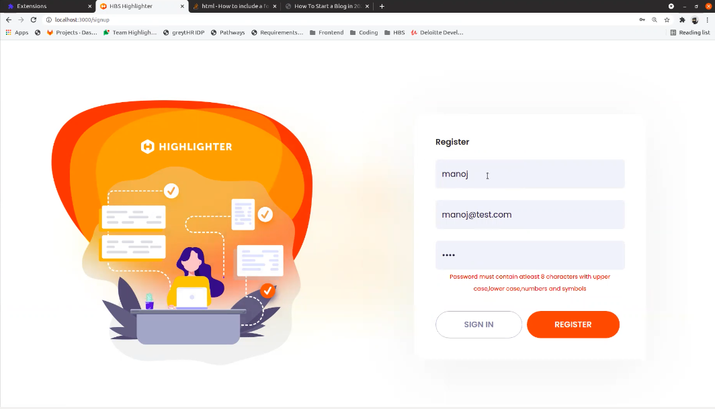

Slide 11
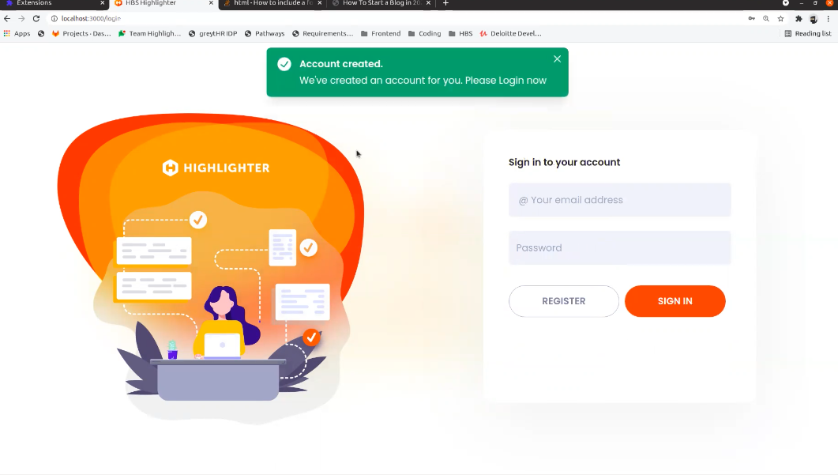

Slide 12
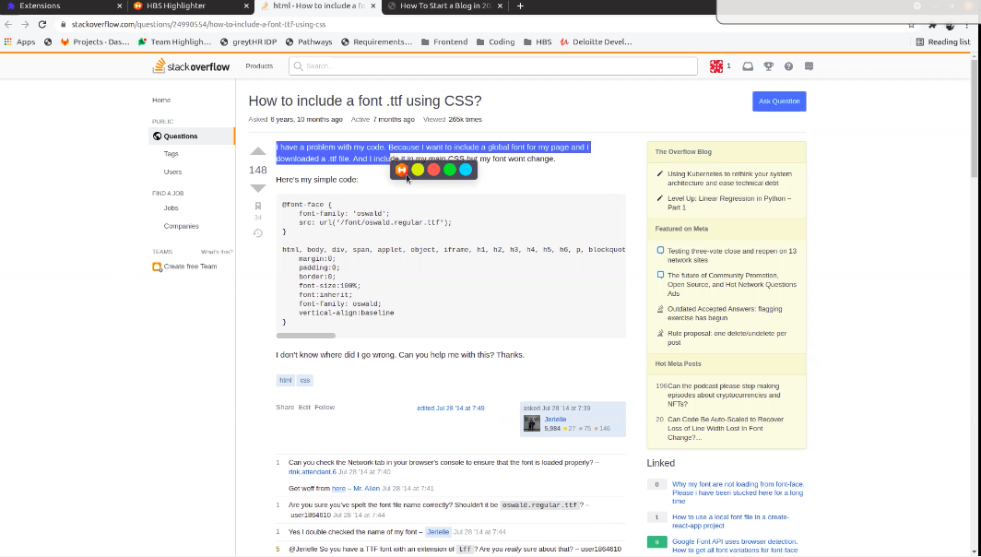

Slide 13
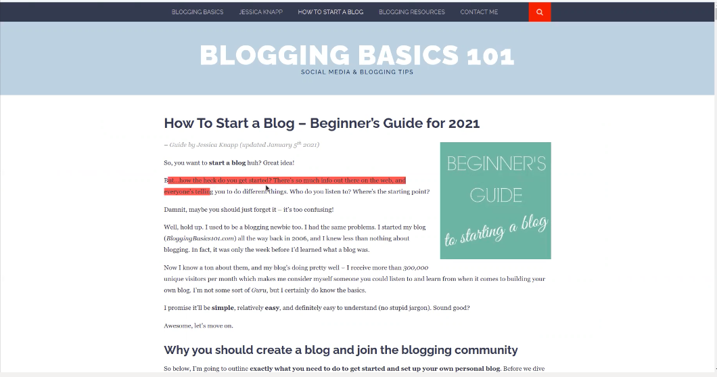

Slide 14
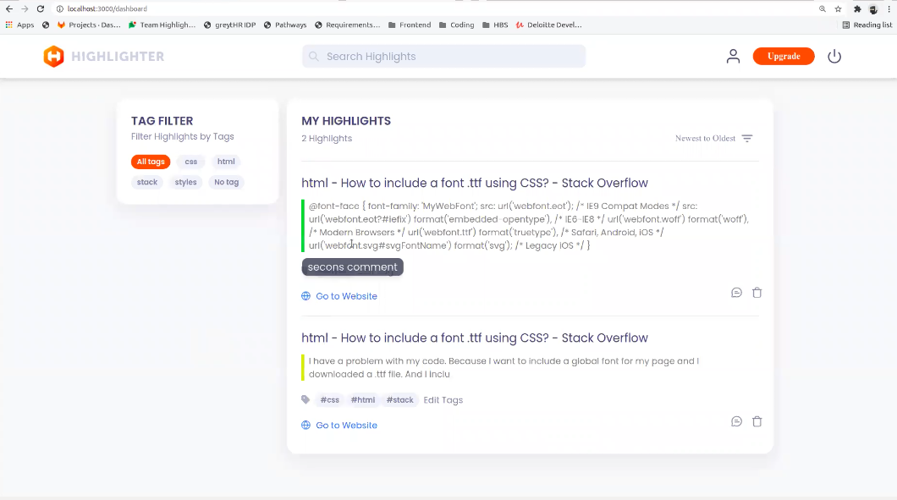

Slide 15
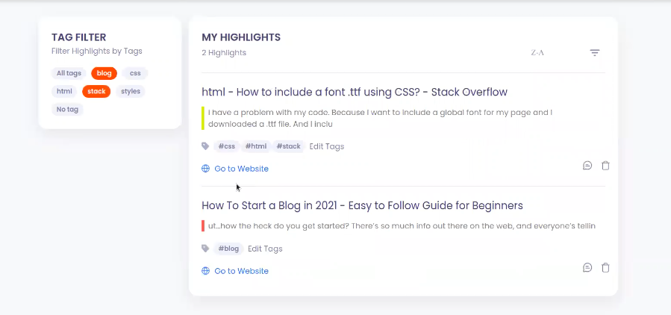
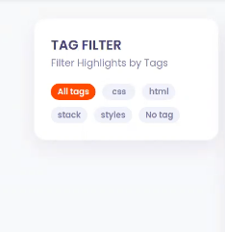

Slide 16
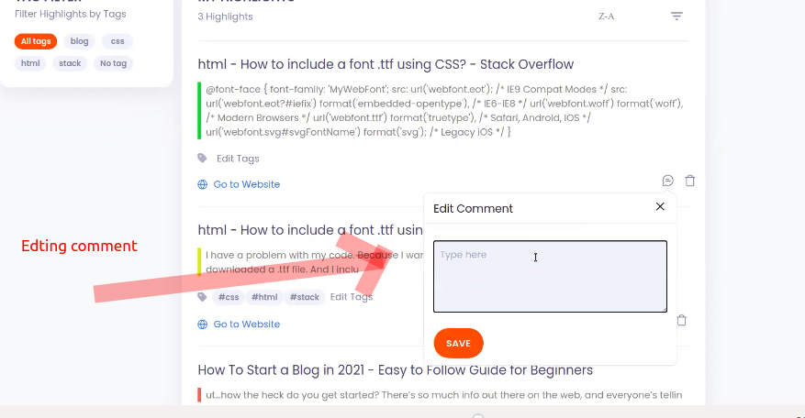

Slide 17
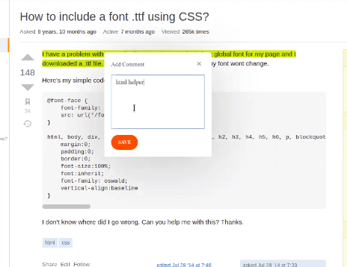
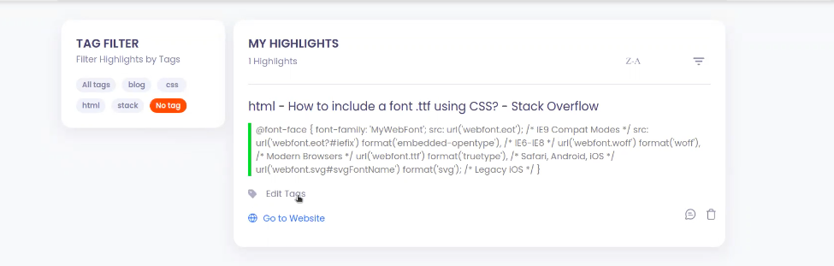

Slide 18
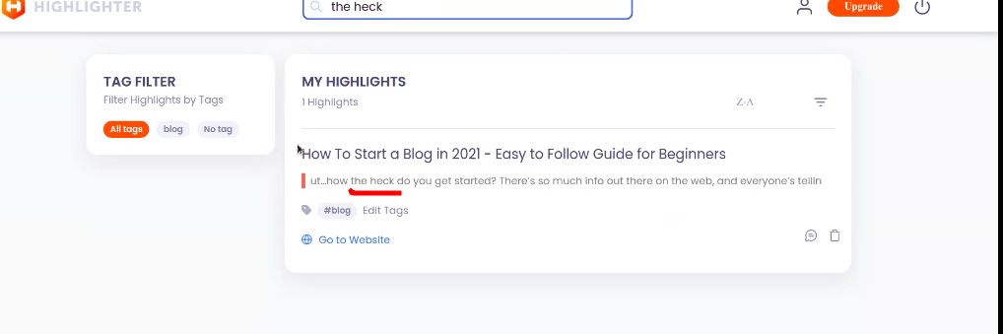

Slide 19
Testing & Quality Assurance
As a Backend developer first we have all test cases in plain text that covers all the aspect how a user can interact with out exposed API, including valid and non-valid test cases.
Then test cases were written using JUnit testing library for automating testing procedure.
For Quality and Assurance testing our tech lead review our code and suggests any changes if required to make the code quality upto the mark.
Front-end team then manually does the Integration testing.
At the end we were able to successfully deliver the product with the required functional requirements which has good quality code and design pattern within the stipulated time period.

Slide 20
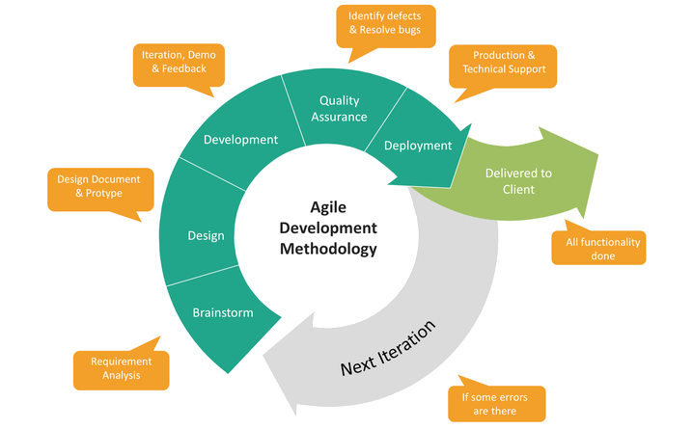
Agile Methodology

Slide 21
Future Plan
Expansion of extension availability to other browsers (Firefox, Edge etc.).
Users be able to save Images and Videos snippets.
We are planning to incorporate AI/ML for suggesting articles based on the saved contents.
Collaboration, two or more users can manage highlights at a single place.
Planning to incorporate a download feature where users can download a single pdf file, csv or docx for selected highlights.
Planning to make a mobile application so that users can view see and manage their saved contents directly through the mobile application.
We will first focus on Students as our Users and then we gradually focus on working professionals.

Slide 22
References
Spring Boot
Documentation : https://spring.io/projects/spring-boot
Spring core : Selenium Express YouTube Channel.
Youtube channel : Java Brains Spring Boot for Begineers.
Thorben Tutorials JPA : https://thorben-janssen.com/ https://vladmihalcea.com/trainings/high-performance-java-persistence/
Gitlab
Gitlab Basics : https://docs.gitlab.com/ee/gitlab-basics/
Security
Real world cryptography
Java Brains YouTube Channel
Extension
Rages and Selection : https://javascript.info/selection-range
Video Demo Link
https://drive.google.com/drive/folders/13nO1nPNy3k-RcrDWa6igZhA1cDxaeMFh?usp=sharing

Slide 23
Mutual Fund Portfolio Analyzer
Mutual Fund Portfolio Analyzer is one of its kind easy to use online platform where a person/investor can easily compare various mutual funds present in his/her portfolio in order to diversify risk.
It is a web-application that provides the following two main features
Change Over time : An investor can see how a mutual fund changed over time and thus can know how it portfolio would be affected by that change.
Overlap : An investor can see how a mutual overlaps with another selected mutual fund. Since it would be useless to but a mutual fund which overlaps a lot with other mutual funds that they have in their portfolio.
So in summary, We are designing a tool to diversify risk of an investor by providing them with various visual easy to use tools.

Slide 24
Usefulness of the Project
Users can see how a mutual fund changed over time with in few clicks in few seconds.
No need to compare them manually which can take upto a week manually.
Users can see how a mutual fund overlaps with another mutual fund, so that users can select a appropriate mutual fund to diversify their risk.
No need to learn any technology tool to derive information from the excel data to learn about their portfolio.
No need to remember different websites corresponding to different Mutual Fund Houses in order to download their excel report every month.

Slide 25
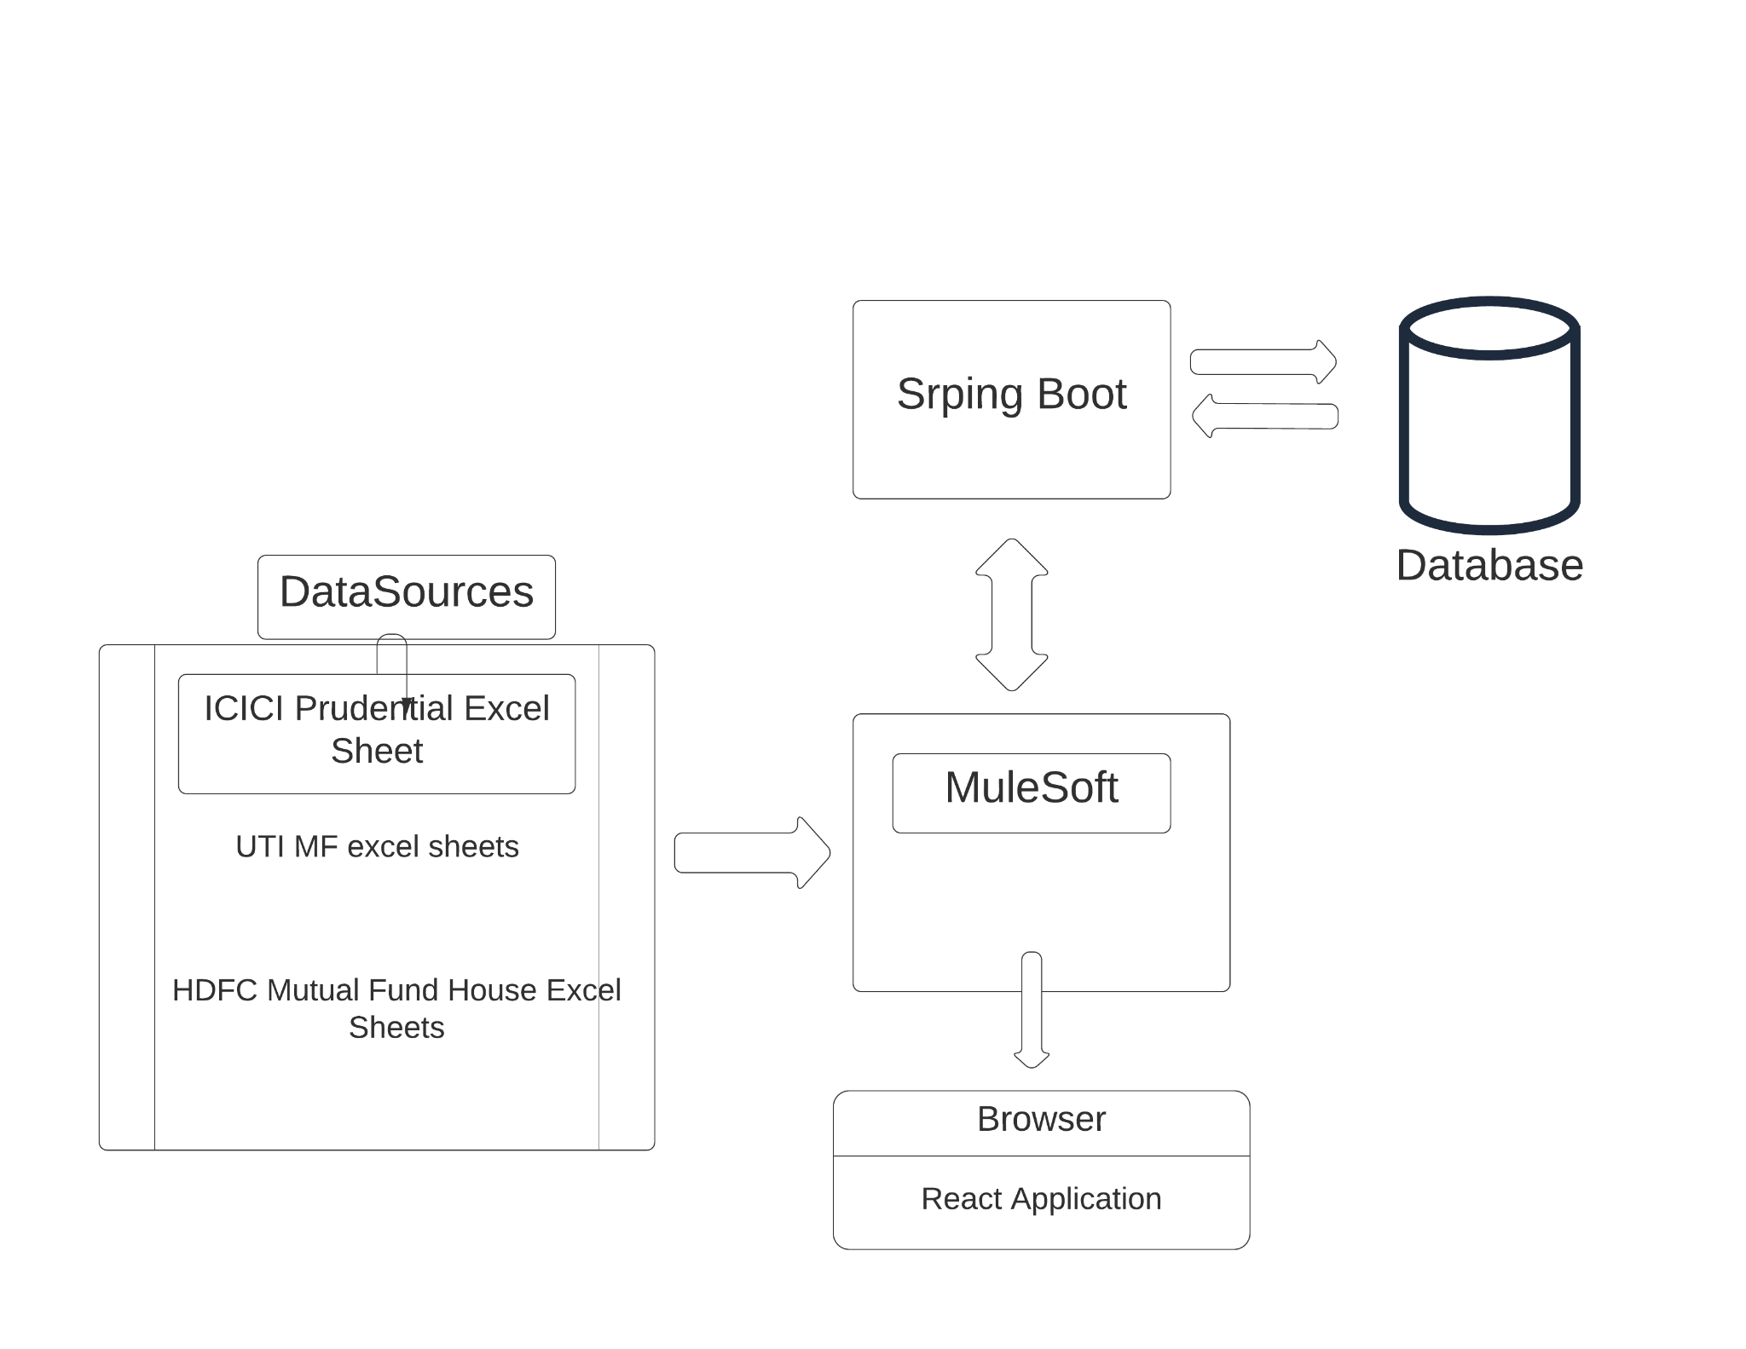
Architecture

Slide 26
Technical Stack
Database
Postgres
Back-end
Spring Boot : Business Logic is handled via Spring Boot Application. APIs are exposed to Front-end.
Mulesoft : Mulesoft is a data integration platform build to connect a variety of data sources and applications and perform various ETL processes. It is most popular for its API LED approach.
Here mulesoft is basically responsible for reading data from different kind of excel sheets and converting them to a normalized format so that they can be saved to the database using the exposed API by Spring Boot.
Front-End
React-web application

Slide 27
Languages Used
As a backend developer we have to build a pipeline that can be extract, transform and load data from excel sheets to the database using Mulesoft. Whereas Business logic should be handled by the Spring Boot Application.
Dataweave
Dataweave language is used in mulesoft for writing transformation logic. It is an immutable, math expression like language.
GUI - Mulesoft Graphical user interface for implementing logic of data flow directly from the GUI components.
Spring Boot
Application Business logic is handled in Spring Boot Java Application. APIs are exposed to the front-end part of the application.
Front-end
React Web Application

Slide 28
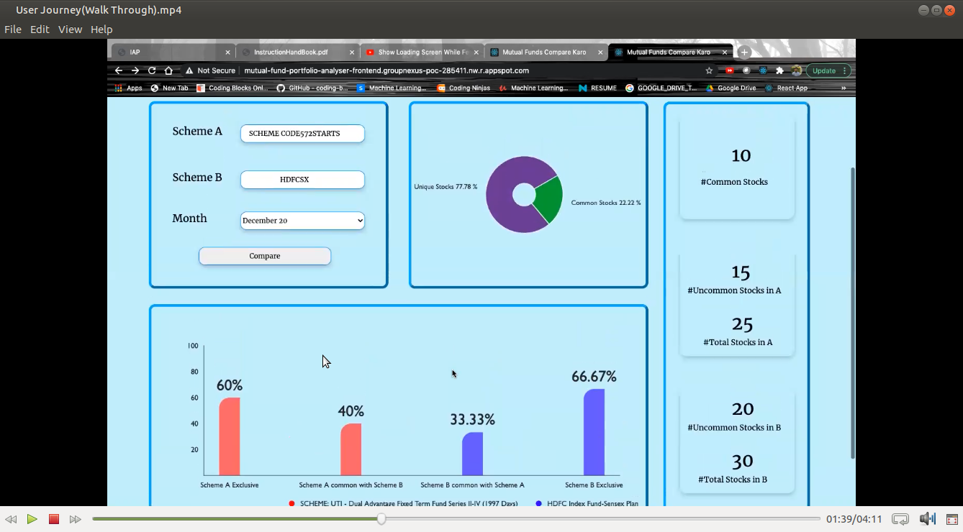

Slide 29
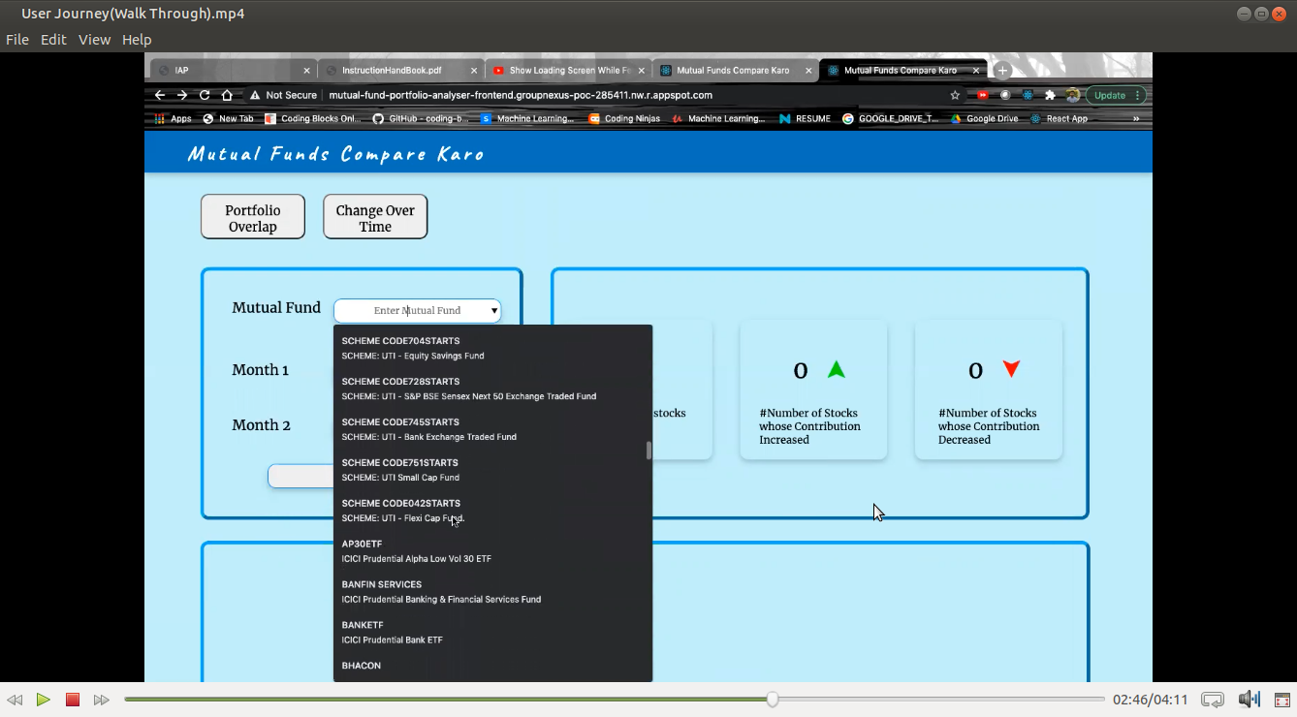

Slide 30
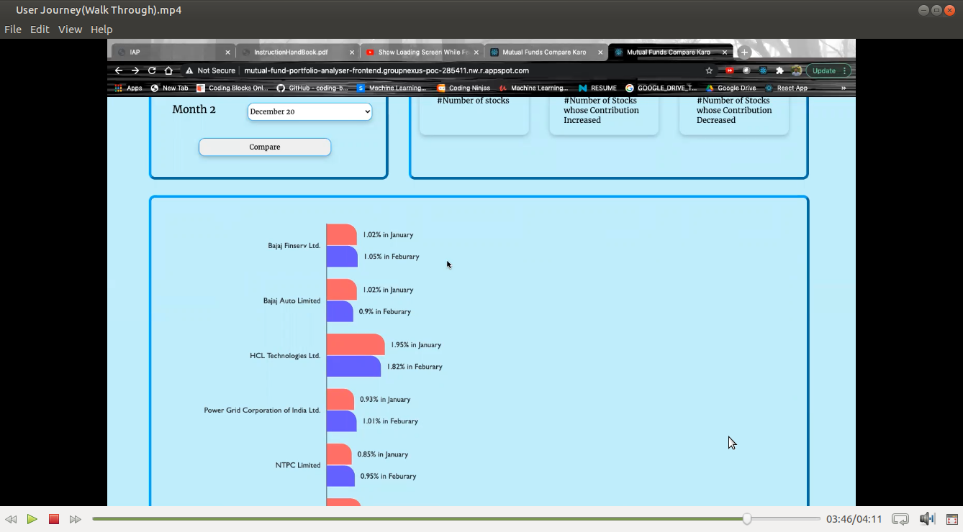

Slide 31
Tools Used and System Requirements
Tools
Anypoint Studio
IntelliJ IDEA
PgAdmin
Gitlab
Languages Used
Dataweave Language
Spring Boot
JPA
System Requirements
16 GB RAM
I7 Intel Processor
Windows 10 / Ubuntu 20.04
JDK 11
Postgresql

Slide 32
Future Plan
Planning to incorporate AI/ML to predict mutual fund performance based upon its previous performance.
Planning to make a newsletter so that users can get instant feedback as soon as a new excel sheet is generated by their corresponding Mutual Fund House.
Write now we are working with only three Mutual Fund Houses ( ICICI Prudential Fund, UTI MF, HDFC Mutual Fund), we are planning to incorporate other mutual fund houses to.
Creating an interface where users can manage their portfolio and track changes in their portfolio over the period of the time.
Adding more graphical tools for visualization and analyzation of the data.

Slide 33
References
Spring Boot
Mulesoft
Documentation : https://docs.mulesoft.com/general/
Blog : https://blogs.mulesoft.com/bloghome/
Mulesoft Tech Zone : https://www.youtube.com/playlist?list=PL61bQcdxsK6_1tb0BbAtAOX_SdtvgQlxV

Slide 34
Thank You

